Slide 1
CSEB534 Java Programming
Chapter 6 : jstl
(JSP Standard Tag Libraries)

Slide 2
What is JavaServer Pages?
JavaServer Pages (JSP) is a technology for developing web pages that support dynamic content which helps developers insert java code in HTML pages by making use of special JSP tags, most of which start with <% and end with %>.
A JavaServer Pages component is a type of Java servlet that is designed to fulfill the role of a user interface for a Java web application. Web developers write JSPs as text files that combine HTML or XHTML code, XML elements, and embedded JSP actions and commands.
Using JSP, you can collect input from users through web page forms, present records from a database or another source, and create web pages dynamically.
JSP tags can be used for a variety of purposes, such as retrieving information from a database or registering user preferences, accessing JavaBeans components, passing control between pages and sharing information between requests, pages etc.

Slide 3
Advantages of JSP
Following is the list of other advantages of using JSP over other technologies:
vs. Active Server Pages (ASP): The advantages of JSP are twofold.
First, the dynamic part is written in Java, not Visual Basic or other MS specific language, so it is more powerful and easier to use.
Second, it is portable to other operating systems and non-Microsoft Web servers.
vs. Pure Servlets: It is more convenient to write (and to modify) regular HTML than to have plenty of println statements that generate the HTML.

Slide 4
Advantages of JSP (cont)
vs. Server-Side Includes (SSI): SSI is really only intended for simple inclusions, not for "real" programs that use form data, make database connections, and the like.
vs. JavaScript: JavaScript can generate HTML dynamically on the client but can hardly interact with the web server to perform complex tasks like database access and image processing etc.
vs. Static HTML: Regular HTML, of course, cannot contain dynamic information.

Slide 5
JSP Architecture
The web server needs a JSP engine, for example, container to process JSP pages. The JSP container is responsible for intercepting requests for JSP pages. This chapter makes use of Apache which has built-in JSP container to support JSP pages development.
A JSP container works with the Web server to provide the runtime environment and other services a JSP needs. It knows how to understand the special elements that are part of JSPs.

Slide 6
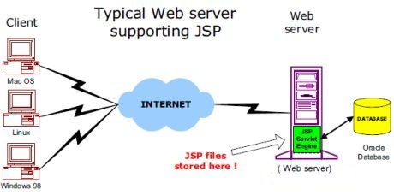
JSP Architecture

Slide 7
JSP Processing
The following steps explain how the web server creates the web page using JSP:
As with a normal page, your browser sends an HTTP request to the web server.
The web server recognizes that the HTTP request is for a JSP page and forwards it to a JSP engine.
This is done by using the URL or JSP page which ends with .jsp instead of .html.
The JSP engine loads the JSP page from disk and converts it into a servlet content.
This conversion is very simple in which all template text is converted to println( ) statements and all JSP elements are converted to Java code that implements the corresponding dynamic behavior of the page.

Slide 8
JSP Processing
The JSP engine compiles the servlet into an executable class and forwards the original request to a servlet engine.
A part of the web server called the servlet engine loads the Servlet class and executes it. During execution, the servlet produces an output in HTML format, which the servlet engine passes to the web server inside an HTTP response.
The web server forwards the HTTP response to your browser in terms of static HTML content.
Finally web browser handles the dynamically generated HTML page inside the HTTP response exactly as if it were a static page.

Slide 9
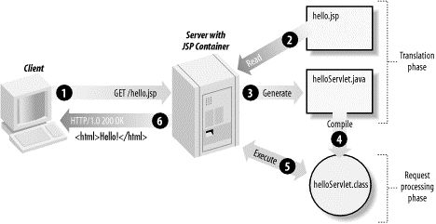
JSP Processing

Slide 10
JSP Life Cycle
The JSP engine compiles the servlet into an executable class and forwards the original request to a servlet engine.
A JSP life cycle is defined as the process from its creation till the destruction. This is similar to a servlet life cycle with an additional step which is required to compile a JSP into servlet.
The following are the paths followed by a JSP:
Compilation
Initialization
Execution
Cleanup

Slide 11
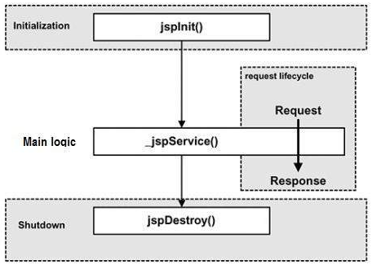
JSP Life Cycle

Slide 12
JSP Life Cycle - Compilation
When a browser asks for a JSP, the JSP engine first checks to see whether it needs to compile the page. If the page has never been compiled, or if the JSP has been modified since it was last compiled, the JSP engine compiles the page.
The compilation process involves three steps:
Parsing the JSP.
Turning the JSP into a servlet.
Compiling the servlet.

Slide 13
JSP Life Cycle - Initialization
When a container loads a JSP it invokes the jspInit() method before servicing any requests. If you need to perform JSP-specific initialization, override the jspInit() method:
Typically, initialization is performed only once and as with the servlet init method, you generally initialize database connections, open files, and create lookup tables in the jspInit method.
public void jspInit(){
// Initialization code... }

Slide 14
JSP Life Cycle - Execution
This phase of the JSP life cycle represents all interactions with requests until the JSP is destroyed.
Whenever a browser requests a JSP and the page has been loaded and initialized, the JSP engine invokes the _jspService() method in the JSP.
The _jspService() method takes an HttpServletRequest and an HttpServletResponse as its parameters as follows −
The _jspService() method of a JSP is invoked on request basis. This is responsible for generating the response for that request and this method is also responsible for generating responses to all seven of the HTTP methods, i.e, GET, POST, DELETE, etc.
void _jspService(HttpServletRequest request, HttpServletResponse response) {
// Service handling code... }

Slide 15
JSP Life Cycle - Cleanup
The destruction phase of the JSP life cycle represents when a JSP is being removed from use by a container.
The jspDestroy() method is the JSP equivalent of the destroy method for servlets. Override jspDestroy when you need to perform any cleanup, such as releasing database connections or closing open files.
The jspDestroy() method has the following form:
public void jspDestroy() {
// Your cleanup code goes here.
}

Slide 16
Elements of JSP : Scriptlet
A scriptlet can contain any number of JAVA language statements, variable or method declarations, or expressions that are valid in the page scripting language.
Following is the syntax of Scriptlet:
You can write XML equivalent of the above syntax as follows:
<% code fragment %>
<jsp:scriptlet>
code fragment
</jsp:scriptlet>

Slide 17
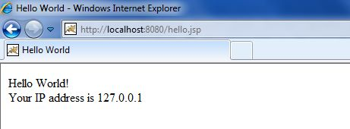
Elements of JSP : Scriptlet
Any text, HTML tags, or JSP elements you write must be outside the scriptlet. Following is the simple and first example for JSP:
<html>
<head><title>Hello World</title></head>
<body>
Hello World!<br/>
<%
out.print("Your IP address is " +request.getRemoteAddr());
%>
</body>
</html>

Slide 18
Elements of JSP : Declarations
A declaration declares one or more variables or methods that you can use in Java code later in the JSP file. You must declare the variable or method before you use it in the JSP file.
Following is the syntax of JSP Declarations:
<%! declaration; [ declaration; ]+ ... %>
You can write XML equivalent of the above syntax as follows:
<jsp:declaration> code fragment </jsp:declaration>
Following is the simple example for JSP Declarations:
<%! int i = 0; %>
<%! int a, b, c; %>
<%! Circle a = new Circle(2.0); %>

Slide 19
Elements of JSP : Expression
A JSP expression element contains a scripting language expression that is evaluated, converted to a String, and inserted where the expression appears in the JSP file.
Because the value of an expression is converted to a String, you can use an expression within a line of text, whether or not it is tagged with HTML, in a JSP file.
The expression element can contain any expression that is valid according to the Java Language Specification but you cannot use a semicolon to end an expression.

Slide 20
Elements of JSP : Expression
Following is the syntax of JSP Expression:
You can write the XML equivalent of the above syntax as follows:
<%= expression %>
<jsp:expression>
expression
</jsp:expression>

Slide 21
Elements of JSP : Expression
Following example shows a JSP Expression :
The above code will generate the following result:
<html>
<head><title>A Comment Test</title></head>
<body>
<p>Today's date:<%=(new java.util.Date()).toLocaleString()%></p>
</body>
</html>
Today's date: 11-Sep-2010 21:24:25

Slide 22
Elements of JSP : Comments
JSP comment marks text or statements that the JSP container should ignore. A JSP comment is useful when you want to hide or "comment out", a part of your JSP page.
Following is the syntax of the JSP comments −
<%-- This is JSP comment --%>

Slide 23
Elements of JSP : Comments
Following example shows the JSP Comments:
The above code will generate the following result −
<html>
<head><title>A Comment Test</title></head>
<body>
<h2>A Test of Comments</h2>
<%-- This comment will not be visible in the page source --%>
</body>
</html>
A Test of Comments

